Slide 1
OS Concept Map 1 – May 13
Agenda
Module A.6 OS Concept Map
Introduce Assignment
Choose Topic
Begin Level 1 Research
Catch-Up
See Spreadsheet for Missing / Incomplete Work
Upcoming
Tue, May 21st : OS Concept Map Due

Slide 2
Assignment Overview
Objective:
To learn about the key parts of a software operating system (OS)
Process:
Level 1 : Rough Research
Level 2 : Organized Research
Level 3 : Final Concept Map
OS Topics:
Windows
Mac OS
Linux
Android
iOS

Slide 3
Important To Do
I will be marking the PROCESS as well as the PRODUCT.
Level 1 : Rough Research
I need to see content in this area!!!
Cut and paste rough research notes as you go.
Level 2 : Organized Research
I need to see stuff from Level 1 appear here!!!
Organise your rough research into common ideas
Reduce duplicated information
Re-word into your own voice
Level 3 : Concept Map
Select only the most important stuff from Level 2
Summarize into short bullet points
You will be MARKED DOWN if concept map is rust a repeat of Level 2

Slide 4
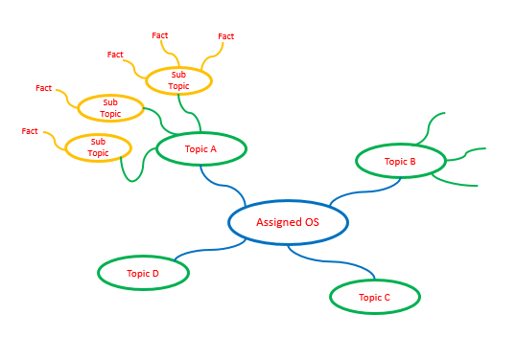
Concept Map
Use PowerPoint or another application of your choice.
Submit as PDF or Image File

